Slide 1
Project 2
Exploratory Data Analysis (EDA)
Shayne Nguyen

Slide 2
Agenda
My Effort
My Follow Up
Q & A

Slide 3
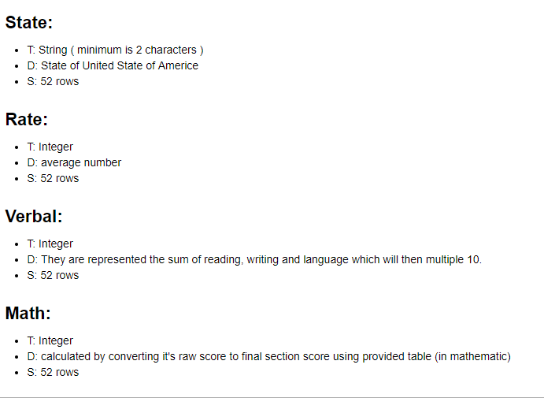
My Effort
Data Dictionary

Slide 4
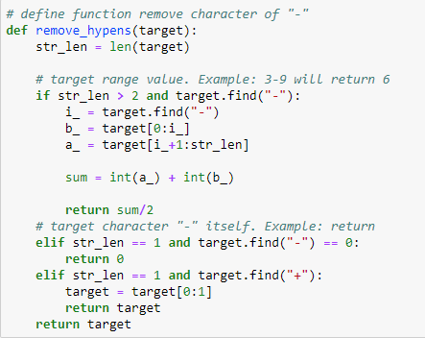
My Effort
Create functions method to clean data

Slide 5
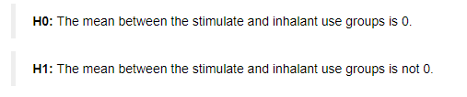
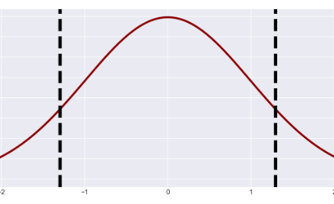
My Effort
Hypothesis test (Q 7.3)
Experience t-statistics and p-value
Fail to reject the null hypothesis

Slide 6
My Follow Up
Explore more case of testing hypothesis
Explore Type I & II Error

Slide 7
THANK YOU

